Slide 1




Survivor – Stickleback Fish Day 4
z

Slide 2
DQ
According to natural selection, species change over time because...
a. | Competition for resources leads to certain traits being selected over many generations
b. | Individuals develop behaviors and traits that they pass on to their offspring
c. | Changes in the environment cause an increase in mutations in the species.
8.LS4.3
8.LS4.4

Slide 3
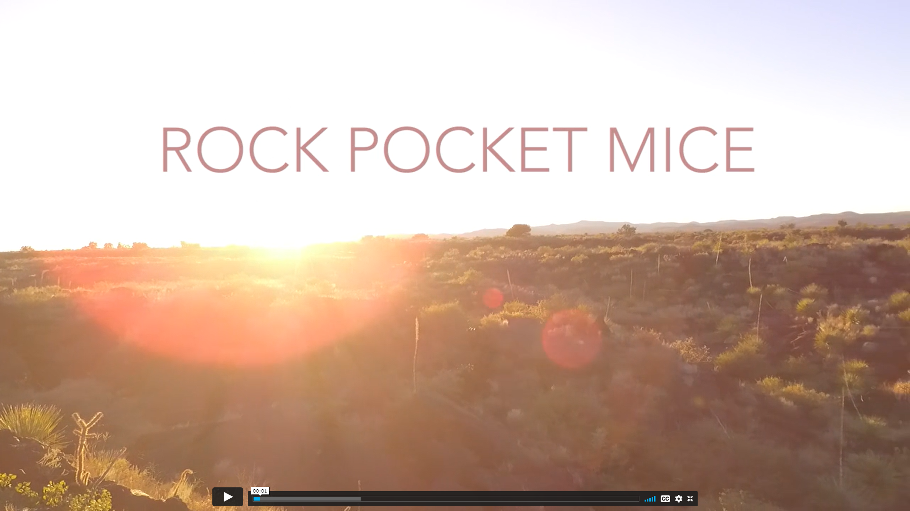
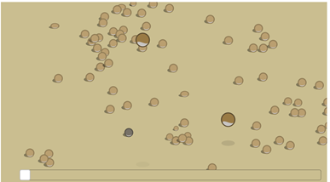
Investigate
Answer the questions on your paper as you watch the reproductive advantage simulation
Watch this video
8.LS4.3
8.LS4.4

Slide 4
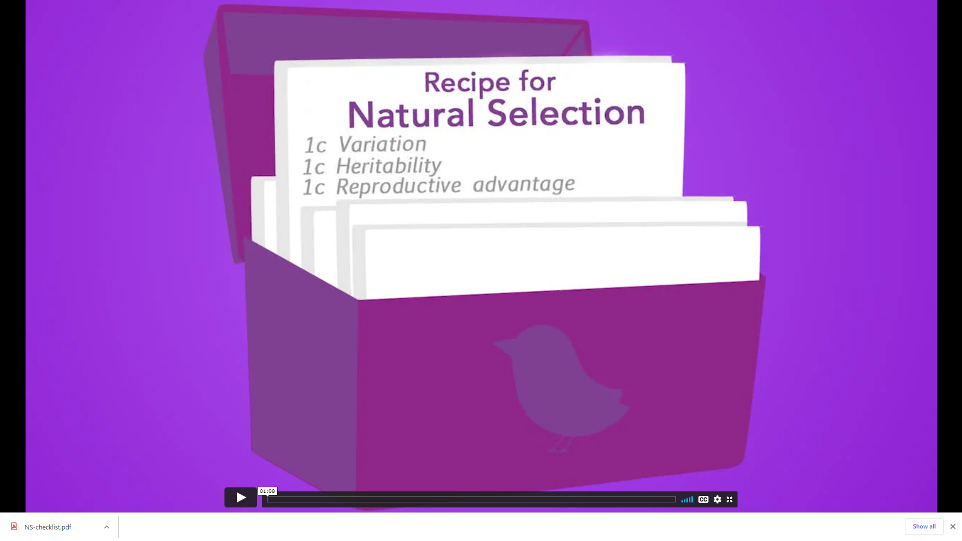
What is Natural Selection?
1.Watch “A Recipe for Natural Selection”.
2.Look at your copy of the Natural Selection Checklist.
3.Is the rock pocket mouse phenomenon an example of natural selection?
Use the Natural Selection Checklist to answer this question. You must provide evidence to support your decisions.
8.LS4.3
8.LS4.4

Slide 5
Stickleback Fish Natural Selection Checklist:
Revisit the Natural Selection Checklist and fill in item #1 (Variation) by checking the appropriate box and creating an evidence statement that sums up the data analyzed in this activity.
Revisit the Natural Selection Checklist and fill in item #2 (Heritability) by checking the appropriate box and creating an evidence statement that sums up the data analyzed in this activity.
Revisit the Natural Selection Checklist and fill in item #3 (Reproductive Advantage) by checking the appropriate box and creating an evidence statement that sums up the data analyzed in this activity.
8.LS4.3
8.LS4.4

Slide 6
Phenomenon Model Revision: Go back to your initial model and use newly learned information to revise your model and explanation of the anchoring phenomenon.
8.LS4.3
8.LS4.4

Slide 7
Gallery Walk & Peer Feedback:
Leave your phenomenon template at your desk.
Walk around the room to view other students models.
Give peer feedback in the box at the bottom of their paper. (don’t repeat the same comment)
Final Phenomenon Model •
Develop a final model to show what happened to the Loberg Lake stickleback fish.
8.LS4.3
8.LS4.4

